Slide 1
College Planning for Freshmen and Sophomores
Presented by:
DHS Counseling Department
Spring 2017

Slide 2
Tonight's Agenda:
The importance of continuing
education beyond high School
Tips for high school success
Looking ahead to college

Slide 3
Who We Are &Where To Find Us
Deb Medenwaldt: 10th grade Academic Advisor
dmedenwaldt@durango.k12.co.us
259-1630, ext. 2266
Rachel Colsman: 11th grade Academic Advisor
rcolsman@durango.k12.co.us
259-1630, ext. 2307
Robert Aspen: 9th grade Academic Advisor.
raspen@durango.k12.co.us
259-1630, ext. 2308
Katie Simkover, 9th grade Counselor
Natalie Bertrand, 10th grade Counselor
Melinda Wood: Counseling Center Assistant
mwood@durango.k12.co.us
259-1630, ext. 2309

Slide 4
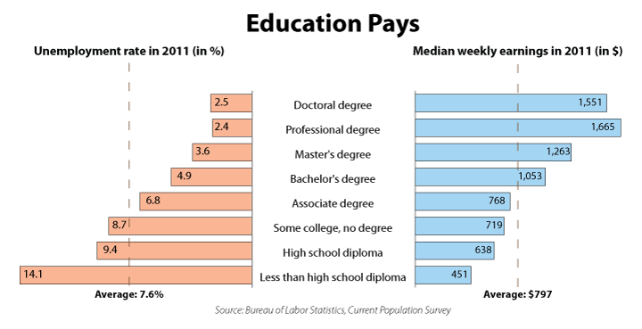
Students Must Continue Their Education Beyond High School Because…

Slide 5
Academic Advisors: Our Purpose and Role
Identify interests
Encourage excellence
Find best postsecondary match
Plan for college
Assist with the college application process
The goal ​is to make information and post­secondary options and opportunities known to every student and support the student to reach his/her goal.

Slide 6
Naviance.com
Username: s.johnd
Password: NaviancePSWD
or
123456

Slide 7
What are Colleges Looking for from Students?
Rigor (the most difficult classes your
student can handle)
GPA
SAT/ACT
Extra Curricular & Volunteer Activities
Essay

Slide 8
A Word About Course Selection
Stretch yourself in those areas where you have identified a personal skill or talent, while maintaining college-prep courses across the board.
Take the most rigorous classes you can handle. 4 x 4

Slide 9
Advice from Top Schools
“When the admissions committee looks at your transcript, it will not focus on whether you have taken any specific course. It will be far more interested to see that you have challenged yourself with difficult coursework, and have done well.”
-- Yale University

Slide 10
Advice from Top Schools
“We are looking for students to display a
healthy ambition through their high school years.”
-- Duke University

Slide 11
AP Classes at DHS
AP Art History of Art
AP Biology
AP Calculus AB
AP Calculus BC
AP Chemistry
AP Computer Science Mobile App.
AP Computer Science A
AP Economics
AP Language and Composition
AP Literature and Composition
AP Human Geography (9th grade)
AP Physics 1
AP Psychology
AP Spanish Language
AP Statistics
AP US History
AP World History

Slide 12
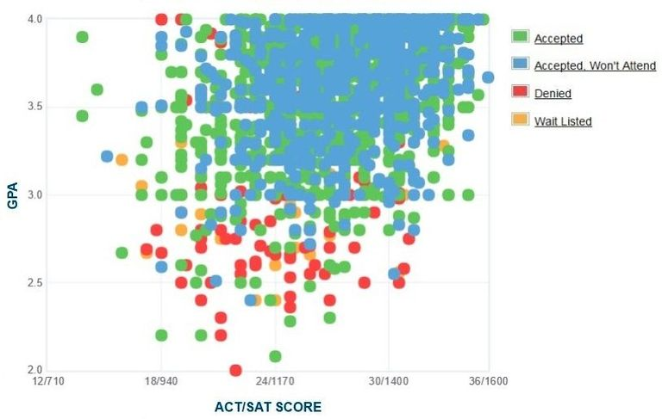
Benefits of Good Grades
Higher rate of college acceptance

Slide 13
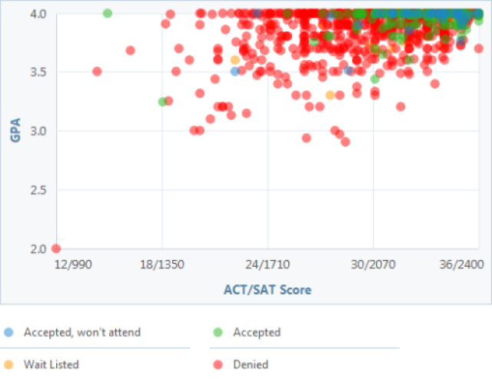
Benefits of Good Grades
Higher rate of college acceptance

Slide 14
More Benefits of Good Grades
GPA
Scholarships
Feel good about school
“How you do one thing is how you do anything”
Academic advisors don’t bug you

Slide 15
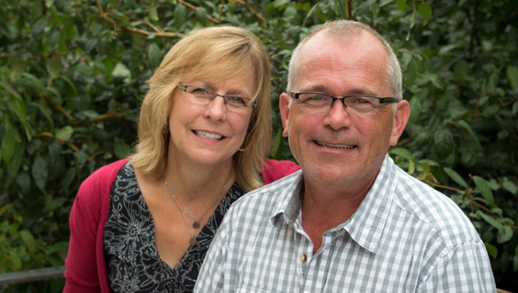
Happy Parents!

Slide 17
How To Improve Your Grades
Tutoring
National Honor Society
Weekly Math tutoring on Tuesdays
Individual help from teachers
Peer tutors
Advisors, counselors, other staff
Improve study time at home
Defined schedule
Practice better study skills
Time management
Quiet spot to study
Summer school (for credit recovery)
Not challenging enough? Lack of interest?

Slide 18
How To Improve Your Grades (cont.)
Ask questions
Study buddies and groups
Make flash cards
Don’t sit next to your friends
Be prepared
Take study breaks
Prioritize
Participate
Sit towards the front
Focus
Take notes
Know your resources
Don’t wait until the last minute
Set goals
Do your homework
Read the assigned material
Attend regularly
Uphold the honor code

Slide 19
Participate,
Participate,
Participate!
Continue extracurricular activities, as schools look at students’ extracurricular activities when considering them for admission.
Continue participation in academic enrichment programs, summer workshops and camps with specialty focuses such as music, arts, science
etc.

Slide 20
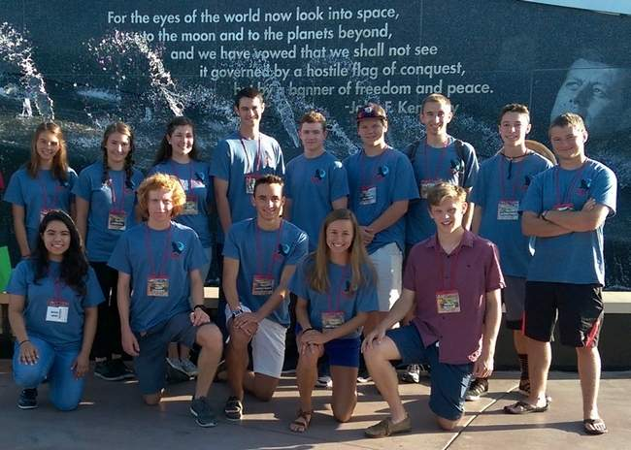
Co-curricular activities

Slide 21
Extracurricular activities

Slide 22
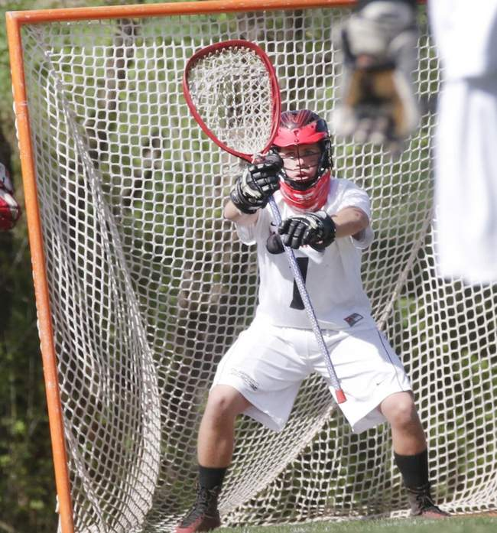
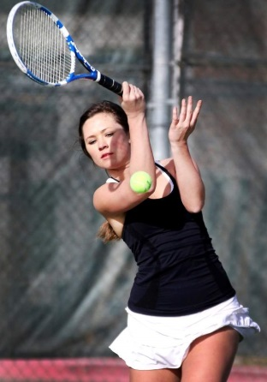
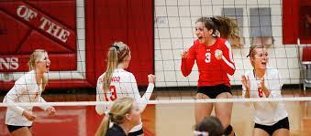
Sports

Slide 23
I Wish…I Knew… Quotes from Juniors
“I wish I knew how to study.”
“My advice is to STAY organized!
“In high school you need to focus on the big picture. Also don’t compare yourself to others.”
“You as an individual are so special and as long as you are trying your very best and being a kind person-you are golden. Everyone has flaws- don’t point them out!”

Slide 24
Quotes continued
“I wish I knew how important my early years are when it comes to grades. I wish I knew how much not having great grades those years can penalize me in the future.”
“Prioritize. Learn how to manage your time. Sometimes sacrifices are necessary.”
“I wish that I knew more about how the things you participate in in high school such as extra-curricular activities and clubs, are very important when it comes to applying to college. It’s not just about grades. “
“Get out in your community-it will help you discover what you really want to do.”
“Get involved in the community, not just for colleges, but for yourself. Biggest Point: Do what you love and thrive.”

Slide 25
Remember, there may not be one ideal college that will fit all your criteria. It is good to cast as wide a net as possible. Keep your options open at this early stage of the process!

Slide 26
Mitigating College Costs
According to the College Board, the average cost of tuition and fees for the 2016–2017 school year was $33,480 at private colleges, $9,650 for state residents at public colleges, and $24,930 for out-of-state residents attending public universities.
1. Anticipate college costs
2. Start a 529 Account
3. Consider concurrent enrollment classes through SCCC or FLC
4. Earn College Credit with AP exams.
5. Search and apply for scholarships. Never too early.

Slide 27
Time Line for Rising Sophomores and Juniors
Stay on track with grades and courses that challenge you and interest you.
Develop strong relationships with teachers.
Consider AP classes or concurrent enrollment.
Take the practice PSAT.
Take the “Mock” SAT offered through SAT prep class and your advisory class
Consider taking SAT Subject Tests at the end of 10th grade and 11th grade.

Slide 28
Time line continued
Begin exploring and researching colleges.
Follow up with colleges from visits and the college fair.
If you are interested in playing athletics, fill out recruiting forms online and come to college plan evening dedicated to athletics
Think about potential careers to explore during your summers and how to maximize your summer time.
Decide as a family how much you can afford.

Slide 29
How Can You Get Your Student Ready for College Now?
Talk to your students about careers and college
Visit college campuses
Look for summer opportunities: jobs, internships or volunteer positions
Explore www.collegeboard.org (this has almost all the info you will need)
Make sure your child reads every night
Help set good study habits
Check Infinite Campus

Slide 30
TONIGHT’S TAKE AWAYS
College is an important step
We want to be there as a teacher, guide and cheerleader
We partner with parents and students
Information is powerful in order to be an informed consumer of post-secondary options
Keeping options open is the best strategy
Aim high and exceed expectations
Get involved and deepen your involvement
Think purposefully about your future...

Slide 31
QUESTIONS ?

