Slide 1
College Planning for Freshmen and Sophomores
Presented by:
DHS Counseling Department
Spring 2017

Slide 2
Tonight's Agenda:
The importance of continuing
education beyond high School
Tips for high school success
Looking ahead to college

Slide 3
Who We Are &Where To Find Us
Rachel Colsman: 9th grade Academic Advisor
rcolsman@durango.k12.co.us
259-1630, ext. 2307
Natalie Bertrand: 10th grade Academic Advisor
nbertrand@durango.k12.co.us
Robert Aspen: 11th grade Academic Advisor
raspen@durango.k12.co.us
259-1630, ext. 2308
Deb Medenwaldt: 12th grade Academic Advisor
dmedenwaldt@durango.k12.co.us
259-1630, ext. 2266
Katie Simkover: 9th grade Counselor
Sean Hembree: 10th grade Counselor
Melinda Wood: Postsecondary Center Assistant
mwood@durango.k12.co.us
259-1630, ext. 2309

Slide 4
Academic Advisors: Our Purpose and Role
Identify interests
Encourage excellence
Find best postsecondary match
Plan for college
Assist with the college application process
The goal ​is to make information and post­secondary options and opportunities known to every student and support the student to reach his/her goal.

Slide 5
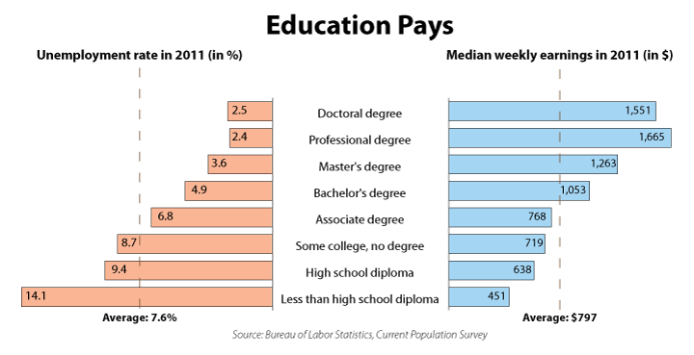
Students Must Continue Their Education Beyond High School Because…

Slide 6
What are Colleges Looking for from Students?
Rigor (the most difficult classes your
student can handle)
GPA
SAT/ACT
Extracurricular & Volunteer Activities
Essay

Slide 7
GPA “Game”

Slide 8
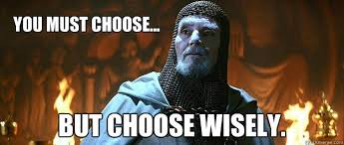
A Word About Course Selection
Stretch yourself in those areas where you have identified a personal skill or talent, while maintaining college-prep courses across the board.
Take the most rigorous classes you can handle. 4 x 4

Slide 9
Advice from Top Schools
“When the admissions committee looks at your transcript, it will not focus on whether you have taken any specific course. It will be far more interested to see that you have challenged yourself with difficult coursework, and have done well.”
-- Yale University

Slide 10
Advice from Top Schools
“We are looking for students to display a
healthy ambition through their high school years.”
-- Duke University

Slide 11
AP Classes at DHS
AP Art - History of Art
AP Biology
AP Calculus AB
AP Calculus BC
AP Chemistry
AP Computer Science Principles
AP Computer Science A
AP Language and Composition
AP Literature and Composition
AP Human Geography (9th grade)
AP Physics 1
AP Psychology
AP Spanish Language
AP Statistics
AP US History
AP World History

Slide 12
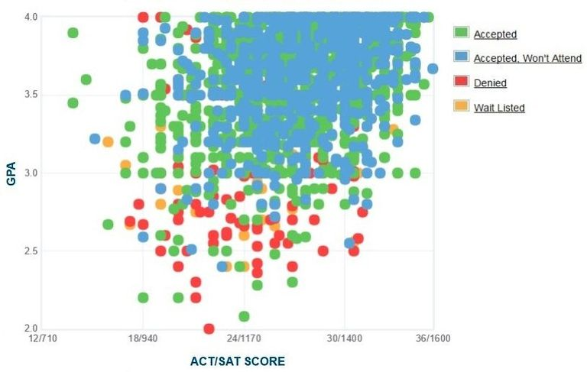
Benefits of Good Grades
Higher rate of college acceptance

Slide 13
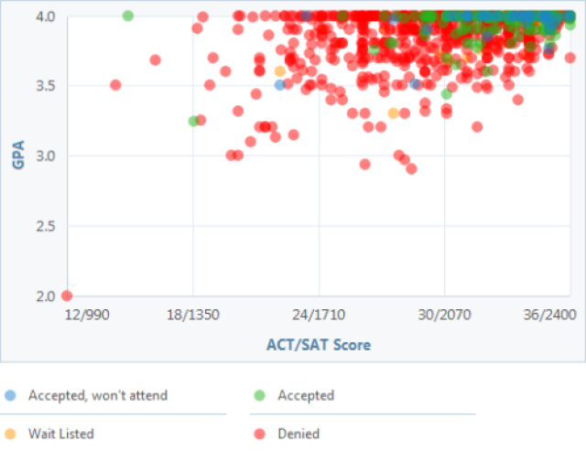
Benefits of Good Grades
Higher rate of college acceptance

Slide 14
More Benefits of Good Grades
GPA
Scholarships
Feel good about school
“How you do one thing is how you do anything”
Academic advisors don’t bug you

Slide 15
How To Improve Your Grades
Tutoring
National Honor Society
Weekly Math tutoring on Tuesdays
Individual help from teachers (build a relationship)
Peer tutors
Advisors, counselors, other staff
Improve study time at home
Defined schedule
Practice better study skills
Time management
Quiet spot to study
Summer school (for credit recovery)
Not challenging enough? Lack of interest?

Slide 16
How To Improve Your Grades (cont.)
Ask questions
Study buddies and groups
Make flash cards
Don’t sit next to your friends
Be prepared
Take study breaks
Prioritize
Participate
Sit towards the front
Focus
Take notes
Know your resources
Don’t wait until the last minute
Set goals
Do your homework
Read the assigned material
Attend regularly
Uphold the honor code

Slide 17
Participate,
Participate,
Participate!
Continue extracurricular activities, as schools look at students’ extracurricular activities when considering them for admission.
Continue participation in academic enrichment programs, summer workshops and camps with specialty focuses such as music, arts, science
etc.

Slide 18
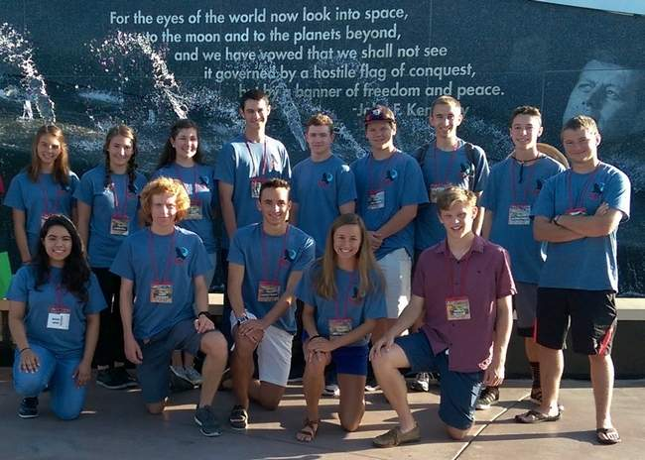
Co-curricular activities

Slide 19
Extracurricular activities

Slide 20
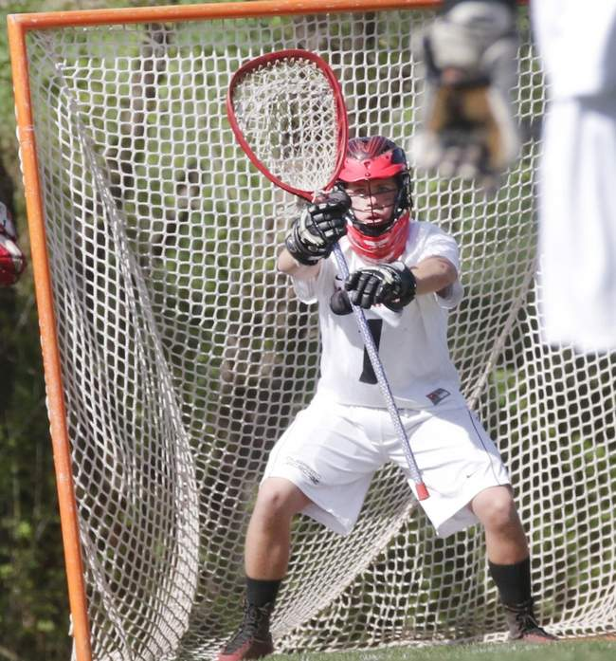
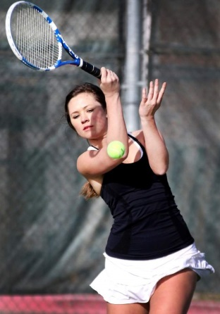
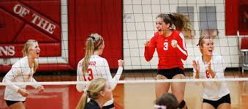
Sports

Slide 21
I Wish I Knew - Quotes from Juniors
“I wish I knew how to study.”
“My advice is to STAY organized!
“In high school you need to focus on the big picture. Also don’t compare yourself to others.”
“You as an individual are so special and as long as you are trying your very best and being a kind person-you are golden. Everyone has flaws- don’t point them out!”

Slide 22
Quotes continued
“I wish I knew how important my early years are when it comes to grades. I wish I knew how much not having great grades those years can penalize me in the future.”
“Prioritize. Learn how to manage your time. Sometimes sacrifices are necessary.”
“I wish that I knew more about how the things you participate in in high school such as extra-curricular activities and clubs, are very important when it comes to applying to college. It’s not just about grades. “

Slide 23
Looking Ahead
Take the practice PSAT – practice tests available at www.collegeboard.org
Practice with Khan Academy
Consider the October PSAT for NMSQT eligibility
Take the “Mock” SAT offered through SAT prep class
Consider taking SAT Subject Tests at the end of 10th grade and 11th grade
Begin exploring and researching colleges
Follow up with colleges from visits and the college fair
If you are interested in being a college athlete, fill out recruiting forms online and come to the NCAA college planning evening
Think about potential careers to explore during your summers

Slide 24
Naviance.com
Username: s.johnd
Password: Demons1
or
123456

Slide 25
Remember, there may not be one ideal college that will fit all your criteria. It is good to cast as wide a net as possible. Keep your options open at this early stage of the process!

Slide 26
Mitigating College Costs
According to the College Board, the average cost of tuition and fees for the 2016–2017 school year was $33,480 at private colleges, $9,650 for state residents at public colleges, and $24,930 for out-of-state residents attending public universities.
1. Anticipate college costs
2. Start a 529 Account
3. Consider concurrent enrollment classes through SCCC or FLC
4. Earn College Credit with AP exams.
5. Search for scholarships, it’s never too early.

Slide 27
How Can You Get Your Student Ready for College Now?
Talk to your student about careers and college
Visit college campuses
Look for summer opportunities: jobs, internships or volunteer positions
Make sure your student reads every night
Help set good study habits
Check Infinite Campus

Slide 28
TONIGHT’S TAKE AWAYS
College is an important step
We want to be there as a teacher, guide and cheerleader and we partner with parents and students
Information is powerful to be an informed consumer of postsecondary options
Keeping options open is the best strategy
Aim high and exceed expectations
Get involved and stay involved
Think purposefully about your future...

Slide 29
QUESTIONS ?

